Slide 1
QEMU Binary Translations
2014/09/25@NCKU Embedded Course
Jeff Liaw
rampant1018@gmail.com

Slide 2
Outline
Introduction of QEMU
Overview
Translation Block
Tiny Code Generator
Porting to New Architecture
Linaro
QEMU Monitor
A debug tool for AArch64/QEMU

Slide 3

Introduction of QEMU

Slide 4
What is QEMU?
Quick EMUlator
QEMU is a FAST! processor emulator
Time for booting linux kernel(buildroot)
QEMU needs 2 sec
Foundation Model needs 12 sec
Simulation V.S Emulation
Simulation – For analysis and study
Emulation – For usage as substitute

Slide 5
Usage of QEMU
Modes:
System-mode emulation – emulation of a full system
User-mode emulation – launch processes compiled for another CPU(same OS)
Ex. execute arm/linux program on x86/linux
Popular uses:
For cross-compilation development environments
Virtualization, device emulation, for kvm
Android Emulator(part of SDK)

Slide 6
QEMU Generic Features
Support
Self-modifying code
Precise exception
FPU
software emulation
host FPU instructions
Dynamic translation to native code => speed

Slide 7
QEMU Full System Emulation Features
Full software MMU => portability
Optionally use an in-kernel accelerator(kvm)
Various hardware devices can be emulated
SMP even on host with a single CPU

Slide 8

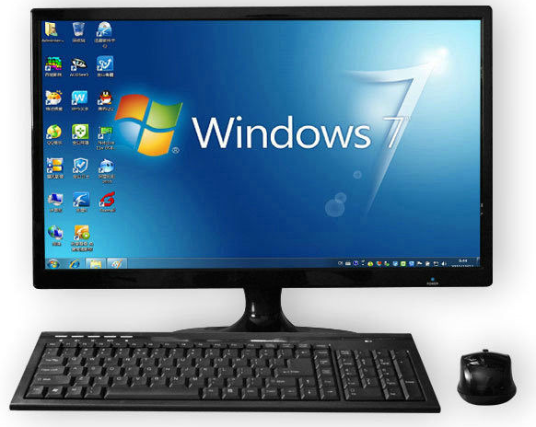

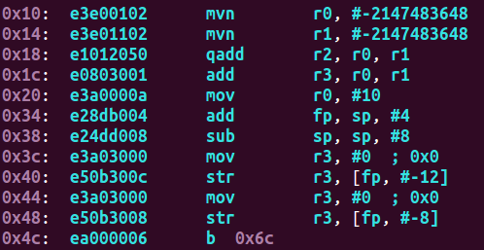
QEMU Emulation Example
Host(Win7/x86) emulate Guest(Linux/arm)
x86 ISA is different from ARM’s ISA
emulate

Slide 9
Dynamic Translation
Target CPU instruction → Host CPU instruction(runtime)
32MB

Slide 10
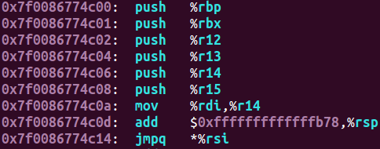
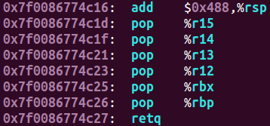
Translation & Execution
initialize the process or and jump to the host code
Overhead!
Main Loop:
IRQ handle
translation
run guest
restore normal state and return to the main loop

Slide 11
Translation & Execution
We need emulation!
Emulation
Host
Main Loop:
IRQ handle
translation
run guest

Slide 12
Basic Block(Translated Block, TB)
Block exit point:
encounter branch(modify PC)
reach page boundary
000081ac<abort>:
81ac: add $sp, $sp #-24
81b0: str $fp, [$sp+#20]
…
81c2: beq $lr
81c6: mov $sp, $fp
…
81d0: ret $lr
Block 1
Branch occur
Block 2

Slide 13
Block Chaining
Jump directly between basic blocks

Slide 14
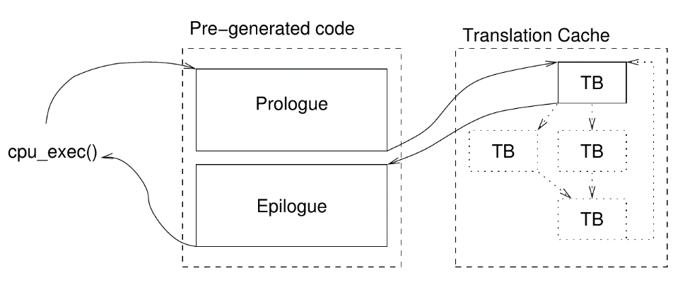
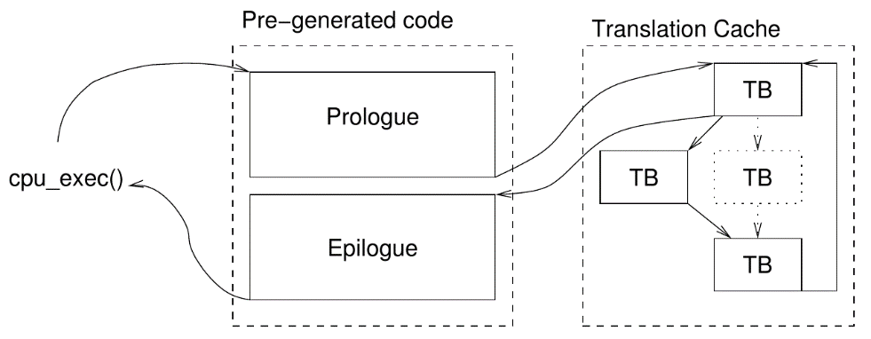
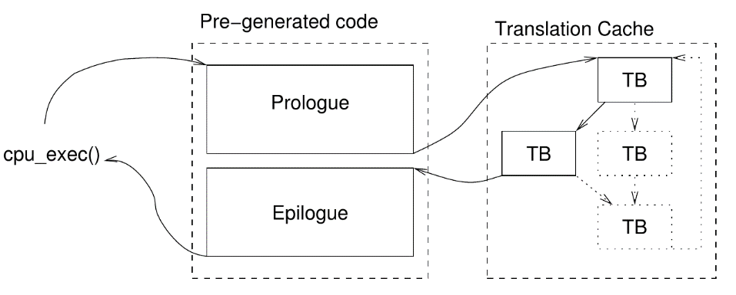
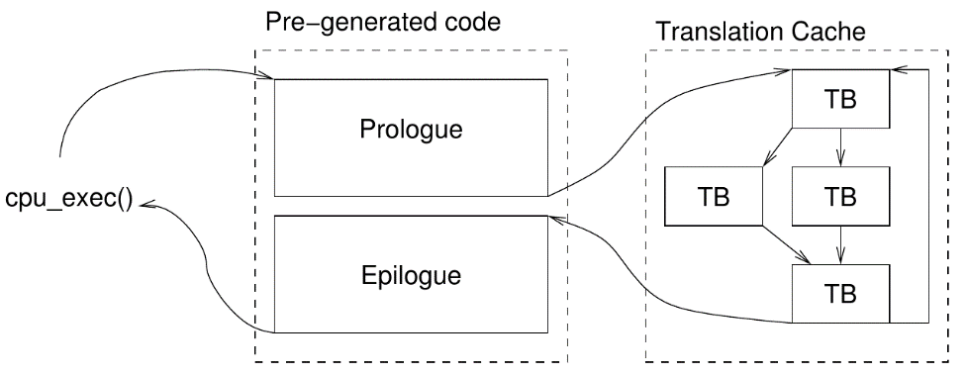
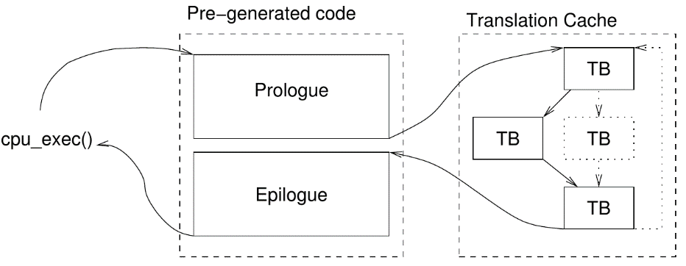
Chaining Steps
tb_add_jump() in “cpu-exec.c”

Slide 15
CPU Execution Flow
Look up TBC by target PC
Cached
N
Translate one basic block
tb_gen_code()
Y
Execute translated code
Chain it to existed block
tb_add_jump()
cpu_tb_exec()
Exceptions:
asynchronous interrupts(unchain)
process I/O
no more TB
Exception handling

Slide 16
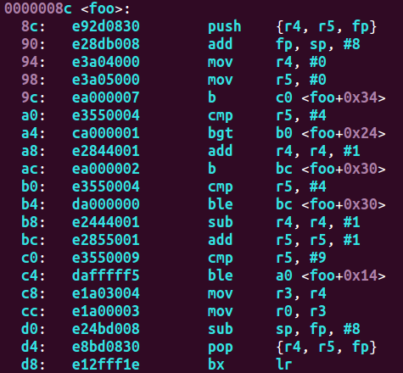
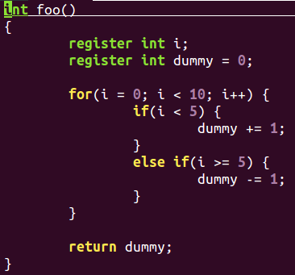
Example
arm-none-eabi-gcc -c -mcpu=arm926ej-s -g foo.c foo.o -O0

Slide 17
Example
dummy++ when i < 5 dummy-- when i >= 5
i count from 0 to 9
r4 = dummy
r5 = i
TB 1
Translation Cache
TB 1
TB 3
TB 4
TB 2
cpu-exec
TB 3
TB 5
TB 2
TB 4
TB 5

Slide 18



CPU dependency(bad idea)
Target CPU
generate host code
Host CPU
Bomb!!!!!!

Slide 19
CPU independency(good idea)
Target CPU
generate host code
Host CPU
All problems in CS can be solved by another level of indirection
-19-

Slide 20
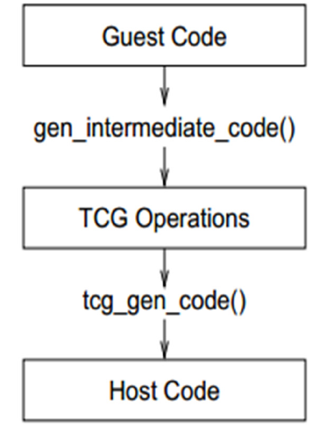
Tiny Code Generator(TCG)
Since QEMU 0.10
Relax dependency
Steps:
Target instruction → RISC-like TCG ops
Optimizations
TCG ops → host instructions
Frontend
Backend

Slide 21

TCG micro-ops
Simple instruction
Ex. add → TCG micro-ops
ARM
Convert
micro-ops
P.S tmp5 and tmp6 are temporary variables

Slide 22
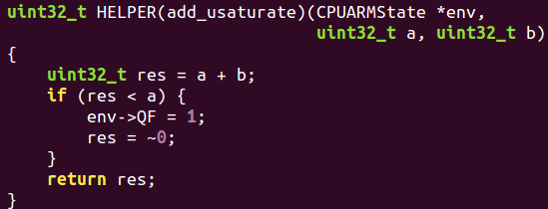
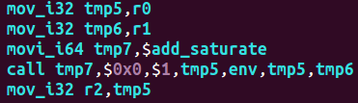
TCG micro-ops
Complicated instruction
Ex. qadd → TCG micro-ops(helper)
ARM
Convert
micro-ops
P.S tmp5, tmp6 and tmp7 are temporary variables

Slide 23
TCG micro-ops
TCG micro-ops
Basic functions
Temporary variables
Divide one instruction to multiple small operations
Helper function
handle complicated instructions

Slide 24
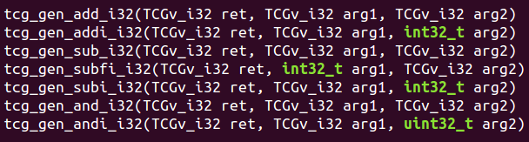
TCG Frontend API
tcg_gen_<op>[i]_<reg_size>
<op> - operation
[i] - immediate or register
<reg_size> - size of register

Slide 25


TCG Frontend API
Temporary variable allocate & delete
Call helper function

Slide 26
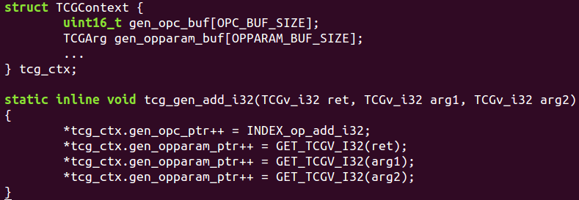
TCG internal
OPC | OPPARAM
op_add_i32 | ret
 | arg1
 | arg2
Two column:
op code(opc)
op parameter(opparam)
OPC
OPPARAM

Slide 27
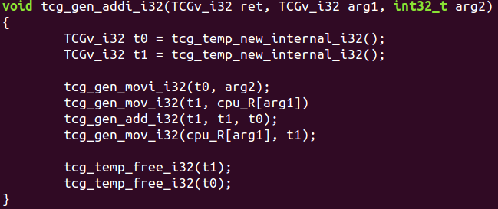
ARM
Convert
micro-ops
OPC | OPPARAM
op_movi_i32
t0
op_mov_i32
arg2
op_add_i32
t1
op_mov_i32
cpu_R[arg1]
t1
t1
t0
cpu_R[arg1]
t1

Slide 28
TCG Backend
OPC | OPPARAM
op_movi_i32
t0
Frontend
op_mov_i32
arg2
op_add_i32
t1
op_mov_i32
cpu_R[arg1]
t1
t1
Backend
t0
cpu_R[arg1]
t1

Slide 29
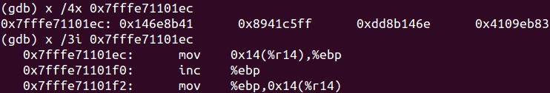
TCG Backend
micro-ops
micro-ops → host code
QEMU on x86-64
Convert
Host machine

Slide 30
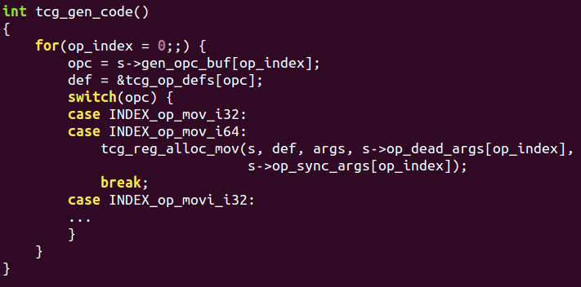
TCG Backend
x86-64 backend example
OPC | OPPARAM
op_movi_i32
t0
op_mov_i32
arg2
op_add_i32
t1
op_mov_i32
cpu_R[arg1]
t1
t1
t0
cpu_R[arg1]
t1

Slide 31
TCG Porting
Porting source tree
Frontend
Backend
qemu/tcg/*/
tcg-target.c
tcg-target.h
qemu/target-*/
cpu.h
translate.c
op_helper.c
helper.c
regs and cpu status declaration
target instruction → micro-op
complicated instruction which can’t be modeled with micro-op
exception handling(ex. divide 0)

Slide 32

Linaro

Slide 33
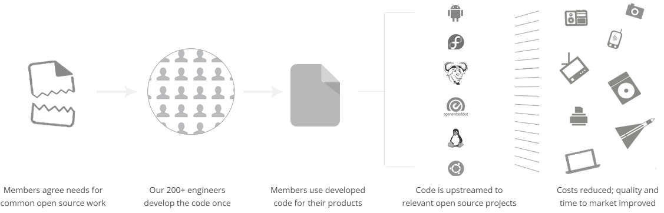
Overview
Build the future of Open Source Software on ARM
Does the core engineering

Slide 34










Members
Core Members
Club Members
Group Members

Slide 35
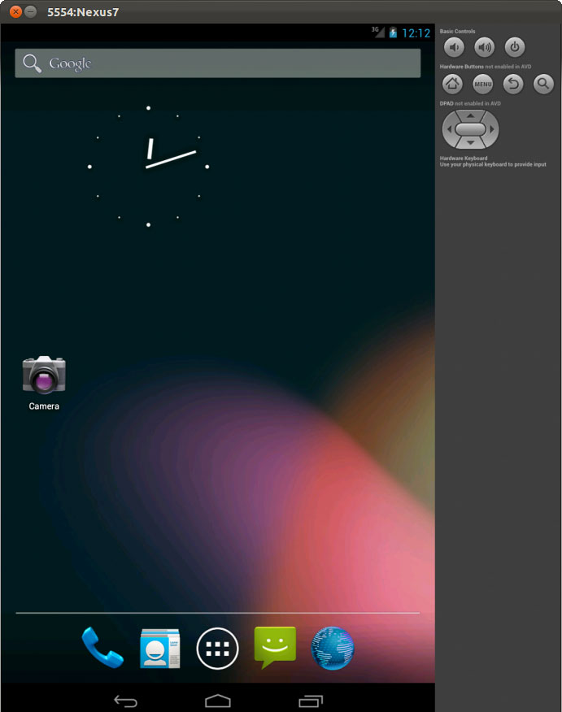
Android L Developer Preview
Android emulator based on QEMU
Differences to mainline QEMU
User Interface
keypad/buttons
accelerated graphics
Emulated Devices
Fast IPC(qemu_pipe)
GSM, GPS, sensors
Ref: http://www.linaro.org/blog/core-dump/running-64bit-android-l-qemu/

Slide 36

QEMU-Monitor

Slide 37
Overview
QEMU provide gdb stub
debug in running image
display general purpose registers(pc, spsr)
single step execution
But can not display system register
hard to debug kernel image

Slide 38
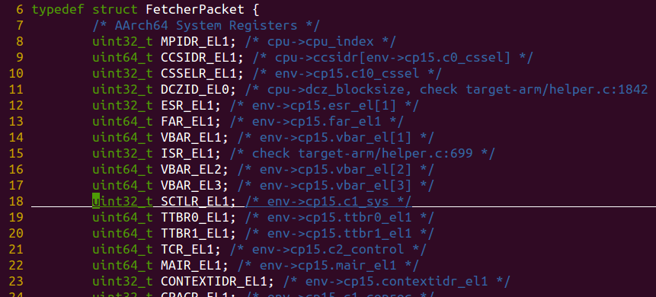
QEMU gdbserver & qemu-monitor
QEMU gdbserver send gdb packet when VM_STATE change
Custom packet through IPC socket
qemu-monitor
Receive Custom Packet
GDB_VM_STATE_CHANGE
Send GDB Packet
IPC Socket
Send Custom Packet
Print Related Information
QEMU
Custom Packet

Slide 39
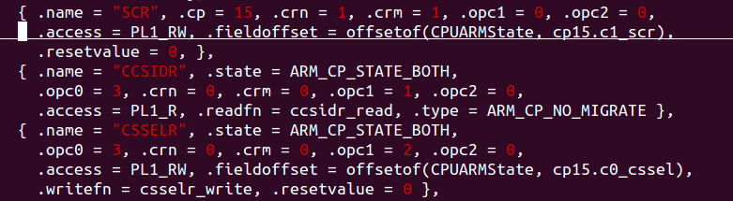
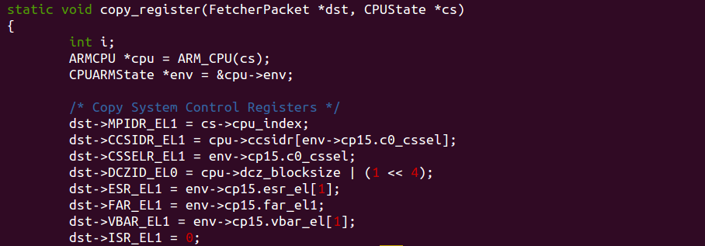
QEMU System Registers Mapping
Some registers are not implemented
Hard-coded
target-arm/helper.c
Hash Key
QEMU Variables mapping to ARM registers

Slide 40
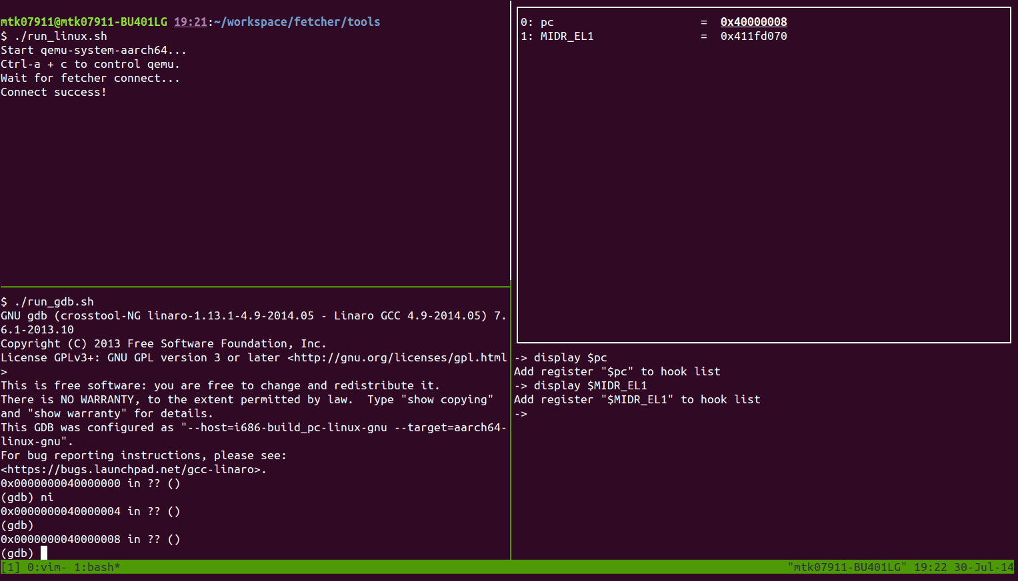
Screenshot

Slide 41
THE END

Slide 42
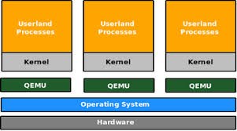
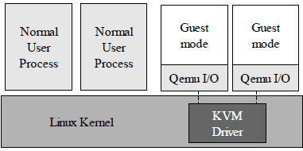
QEMU & KVM
QEMU
run independently
QEMU + KVM
qemu(userspace tool)
kvm(hypervisor)

